Slide 1
STUDENTS CREDENTIALS SHARING BASED DECENTRALIZED APPLICATION
GROUP IV
Guide : Asst.Prof.Rahul Gopal

Slide 2
GROUP MEMBERS
ADITYA R NAIR (STC20CS006)
ANN MARIA SUNNY(STC20CS018)
NADAR NAWAS (STC20CS040)
STEEVE BINU BABY(STC20CS055)

Slide 3
CONTENT
1) ABSTRACT
2) SRS

Slide 4
ABSTRACT
In the era of digital transformation, traditional methods of verifying and sharing academic credentials face numerous challenges, including fraud, inefficiency, and a lack of transparency. This abstract outlines the development of a decentralized application (DApp) utilizing blockchain technology to securely manage and share student credentials .This introduces a novel approach to credential sharing by leveraging the power of blockchain, specifically Ethereum, to create a tamper-proof, transparent, and user-centric system. In this decentralized ecosystem, students are given ownership of their academic records, ensuring privacy and control over their data .

Slide 5
SRS
INTRODUCTION
Most digital credential sharing schemes adopt centralised storage and management of credentials and associated keys, which could lead to a single point of failure and high security risks.
If data sharing is unavoidable, one approach to strengthen privacy is to minimize the data being disclosed.
Our design is flexible in that the user has full control of the credentials .
To increase the scalability, the proposed system uses a secure off-chain storage mechanism(IPFS). The performance and viability of the proposed architecture is analyzed by using an Ethereum based prototypical implementation.

Slide 6
SRS
LANGUAGES USED
Web3js
Metamask
Solidity
React
node.js

Slide 7
SRS
Front End (Web Dapp)
React JS
Back End
NodeJS
Hosting Services
Metamask

Slide 8
implementation
For the first-level implementation, three different types of stakeholders are considered:
School
Student
Company
Student dashboard offers three options:
(i) to view the uploaded credentials
(ii) to view the access requests sent by the companies
(iii) to grant access after viewing those access requests.

Slide 9
IMPLEMENTATION
Company dashboard has three options:
(i) to view the list of schools and the students enrolled under a selected school
(ii) to send an access request
(iii) to view the credentials once the students grants access.

Slide 10
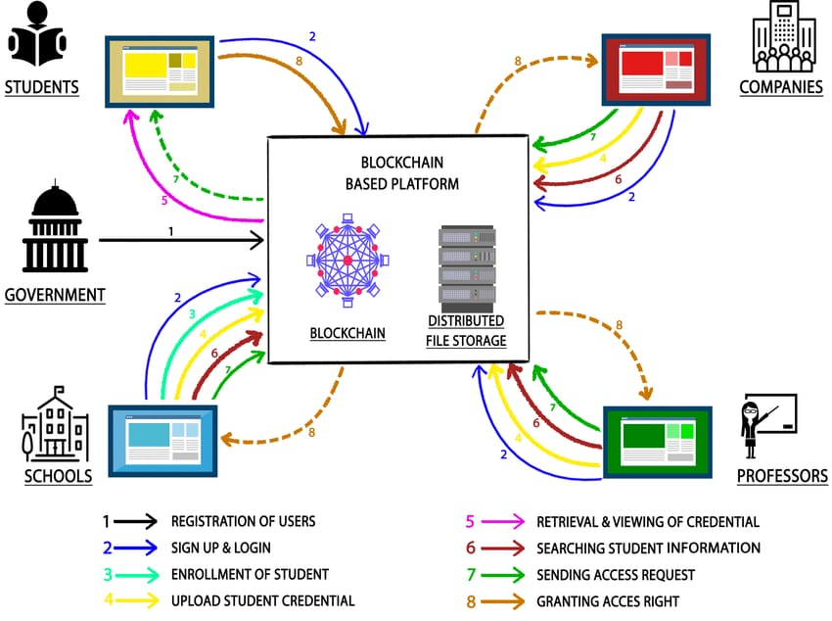
Proposed system

Slide 11
PROPOSED SYSTEM
(i) Registration of User: assigns a unique ID to every user. The way to create unique IDs is discretion of the government body.
(ii) Sign-up and Login of User: allows users to undergo one-time sign-up process which would ease future logins.
(iii) Enrollment of Student: happens at the time of admission.
(iv) Uploading of Credential: by school or company or professor.
(v) Retrieval and Viewing of Credential: enables students to retrieve their credentials.
(vi) Searching Student Information: facilitates stakeholders to search student’s information

Slide 12
PROPOSED SYSTEM
(vii) Sending Access Request: allows schools, professors and companies to send access request to students to view their credentials.
(viii) Granting Access Right: empowers students to approve the received access requests.

Slide 13
THANK YOU

